Slide 1
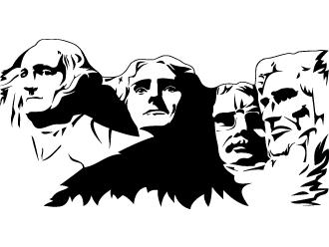
Presidents
By: David Wilson

Slide 2
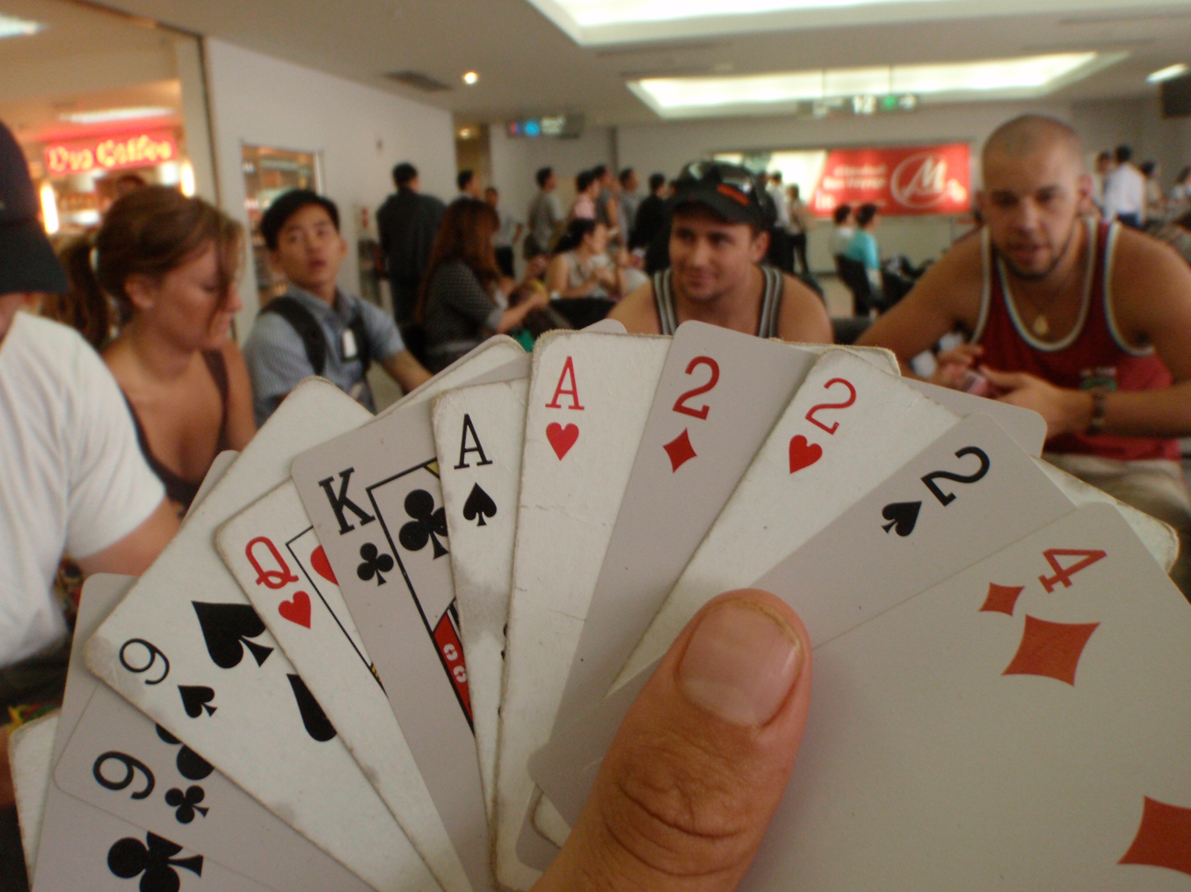
What is presidents?
A card game that uses a standard 52 card deck. (2-8 players)
Objective: To get rid of your cards before the other players.
How? By beating the hand put down by the player in front of you.
Diamonds, Clubs, Hearts, Spades
2’s high
Presidents, Chinese poker, a-hole

Slide 3
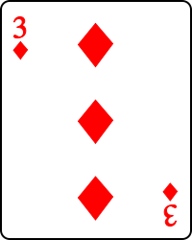
Sequence
Shuffle/ Deal
3 of Diamonds starts
Clockwise turns. Pass.
Must play the same number of cards as preceding player.
Same rules as poker: Flush, Straight, Full house, three of a kind, etc

Slide 4

Why is it called presidents?
Typically played as a drinking game.
Winner is the President. Can tell all other players to drink.
Hierarchy.

Slide 5
Questions?
(Related to the game)

Slide 6
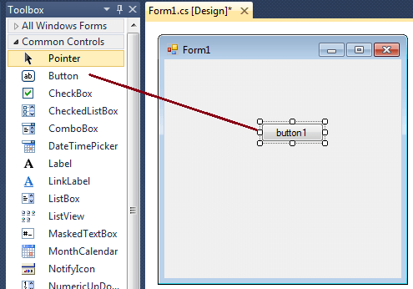
How will you do it?
GUI application using forms in C#.
Multiplayer online game
Sockets provided by .NET

Slide 7
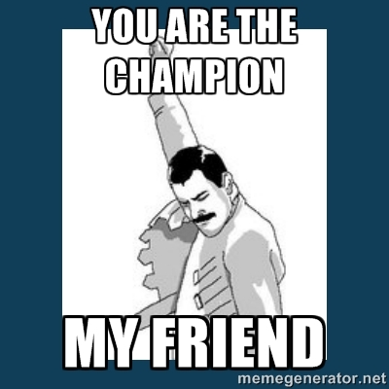
Aspects of the Project
GUI
Main menu (options)
Lobby (start game)
Game screen
Victory/ loser screen? (Replay button [voting])
Game screen
Cards (toggle select)
Play/ Pass

Slide 8
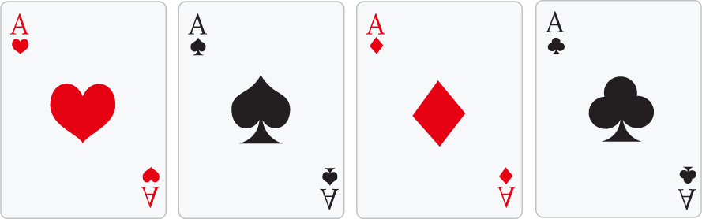
Aspects of the Project
Assets
Cards
Images
C# panels
Process
Card struct (suite [enum], numeric value)
Player has a deck, list of cards

Slide 9
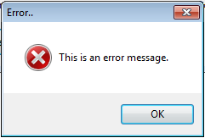
Aspects of the Project
Prevent invalid moves
Same number of cards, better hand?
Save information about the last hand played for drawing/ comparison purposes
Message boxes, make another move/ pass

Slide 10
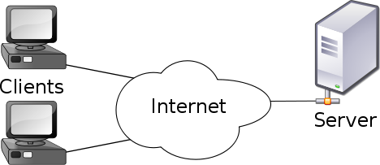
Aspects of the Project
Networking
Client/Server
TcpListener
TcpClient
Clients see the display from server (DB), send messages to server, updates display in real time
Message passing
Event driven

Slide 11
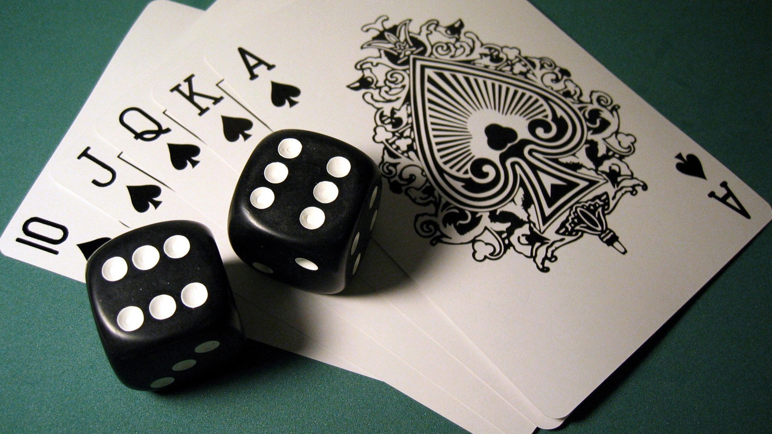
THANKS!
Questions?

